Slide 1


Exploring Housing Costs Across the United States: A Data Science Analysis
Alpha Bah, CTEC 128, 12/11/2023
Professor Wilson

Slide 2




Introduction & Objective
As a college student and future homeowner, I am passionate about data science because it ties into our everyday lives without data we wouldn't be able to come up with most conclusions and get to the bottom of how things work. I aim with this project to explore and analyze housing costs across various states in the U.S., understand the fluctuations in housing prices, and the influencing price factors. I also intend to collect and analyze datasets from the U.S Census Bureau and other credible sources which will contain information about housing expenses, demographic trends, employment rates, and other economic factors across states. This project will not only help me learn how to become a better data scientist but also help others analyze data in the housing market.

Slide 3

Key players in the housing market
Buyers and Sellers: These are the primary participants. Buyers seek properties for personal use or investment, while sellers offer properties for sale.
Real Estate Agents: They facilitate transactions between buyers and sellers, earning commissions on sales. They provide market expertise, assist with negotiations, and handle paperwork.
Lenders and Mortgage Brokers: Banks, credit unions, and mortgage brokers provide financing for home purchases through mortgages. They determine eligibility, loan terms, and interest rates.
Developers and Builders: They construct new properties, contributing to the housing supply. They might build single-family homes, condominiums, or apartment complexes.
Government and Other Bodies: Various government agencies regulate the housing market through policies, zoning laws, and tax incentives. These entities influence affordability, accessibility, and market stability.

Slide 4
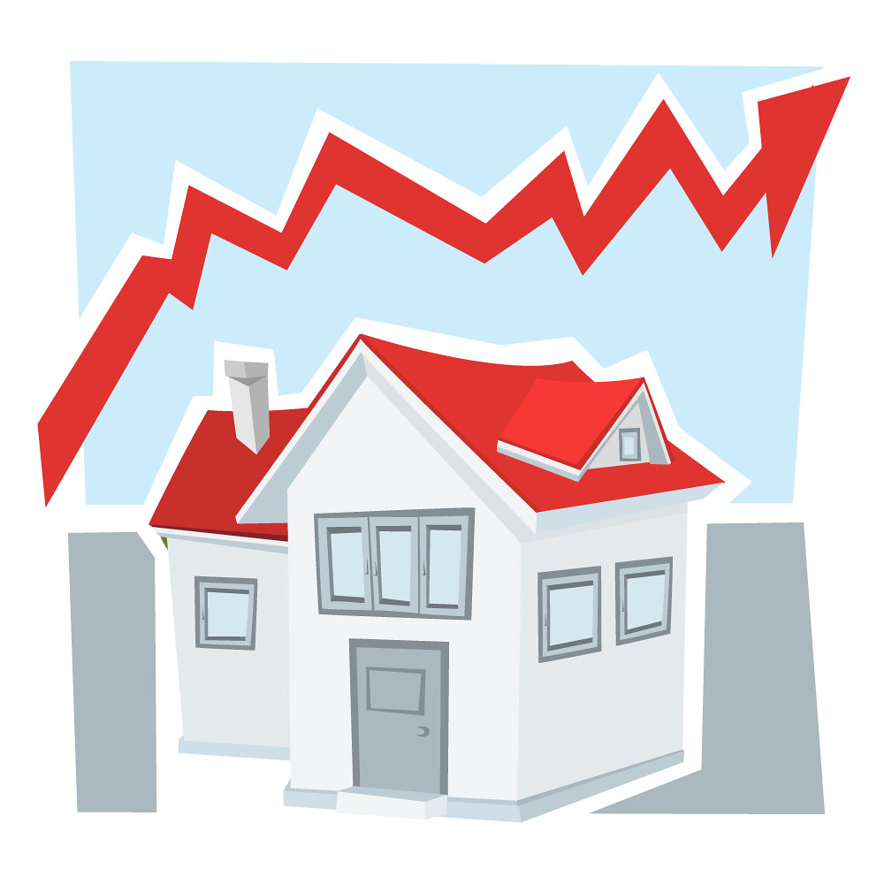
Factors influencing the housing market
Supply and Demand: Like any market, the housing market operates on the principles of supply and demand. When the demand for houses is high and the supply is limited, prices tend to rise. Conversely, when supply exceeds demand, prices might decrease.
Economic Factors: Various economic factors influence the housing market. These include interest rates (set by the Federal Reserve), employment rates, income levels, and overall economic stability. For example, low-interest rates often encourage borrowing for mortgages, increasing demand for homes.
Location, Location, Location: The location significantly affects housing prices. Factors like proximity to good schools, job opportunities, amenities the location can offer, and safety
Real Estate Cycles: The housing market experiences cycles of boom and bust. During a boom, prices rise due to high demand and speculation. In a bust, prices fall, leading to a decrease in market activity.

Slide 5
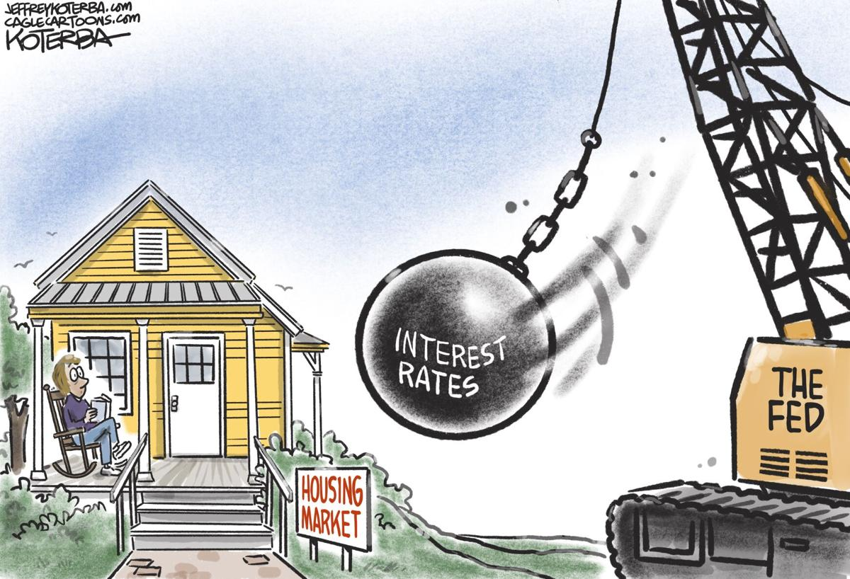
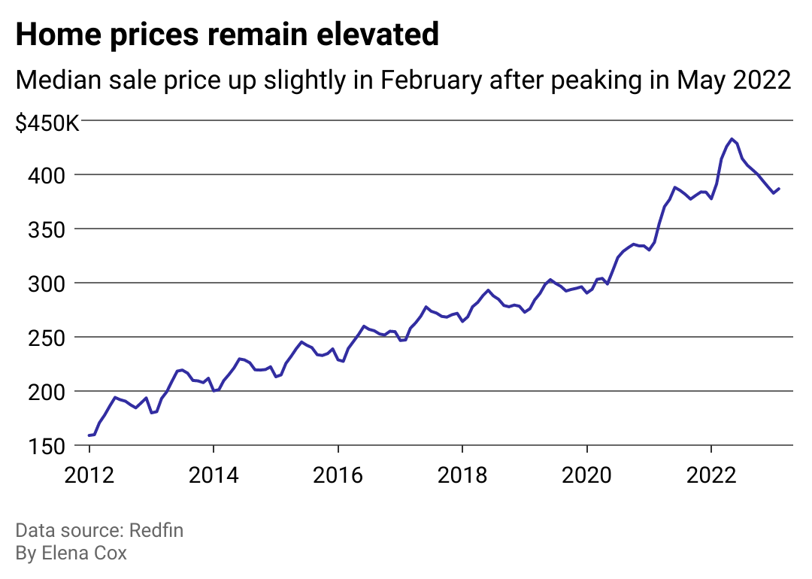


Slide 6


What can we do to prevent the elevation in housing prices
Build More Homes: Make it easier to build houses by simplifying rules for land use and construction.
1
Help People Afford Homes: Offer government aid and tax breaks to make housing cheaper for those with lower incomes.
2
Stop Price Tricks: Set rules to prevent people from unfairly raising house prices for profit. Watch how money is lent and invested to prevent housing bubbles.
3
Offer Different Kinds of Homes: Build various types of homes like apartments or small houses to suit different needs and budgets.
4
Improve Money and Jobs: Create policies that make it easier for people to get good jobs and earn more. This indirectly helps people afford homes.
5
Work Together with Communities: Listen to what communities want when planning cities. Build places where everyone can live comfortably and sustainably.
6

Slide 7
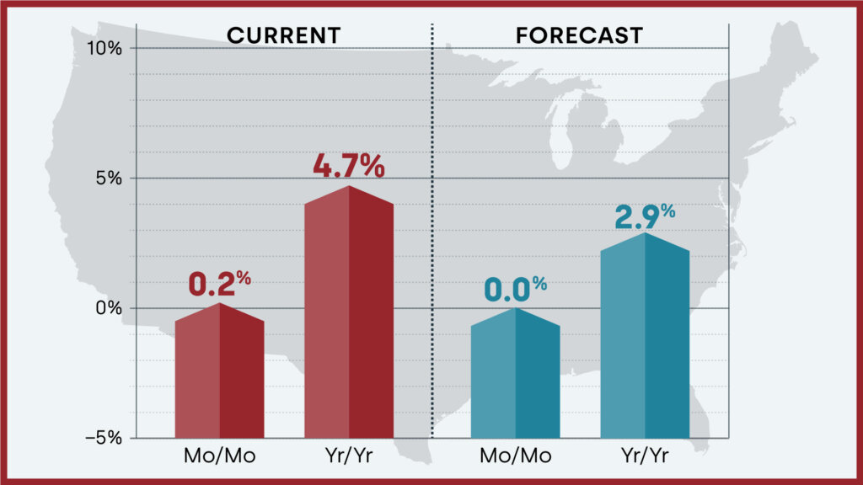
Forecast for housing market for 2024

Slide 8
References
Census Bureau. Explore census data. (n.d.). https://data.census.gov/profile/United_States?g=010XX00US
Complete ranking housing markets per state – Complete Data. Fit Small Business. (2023, December 12). https://fitsmallbusiness.com/complete-ranking-housing-markets-per-state-in-2022-complete-data/
Crime rate by state 2023. Wisevoter. (2023, May 11). https://wisevoter.com/state-rankings/crime-rate-by-state/#washington

